Slide 1
Implementing K-Trusses
Tillmann Fiehn
Sebastian Arnold

Slide 2
Implementing K-Trusses
Paper Source:
Jonathan Cohen: Graph Twiddling in a MapReduce World. Computing in Science & Engineering 2009.
Mailing List
Project Outline
Announcement of a JIRA issue
[jira] [Created] (MAHOUT-710) Implementing K-Trusses
Listing of the algorithms
Pseudo code
Package proposal

Slide 3
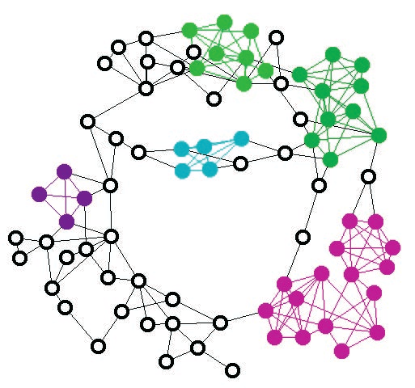
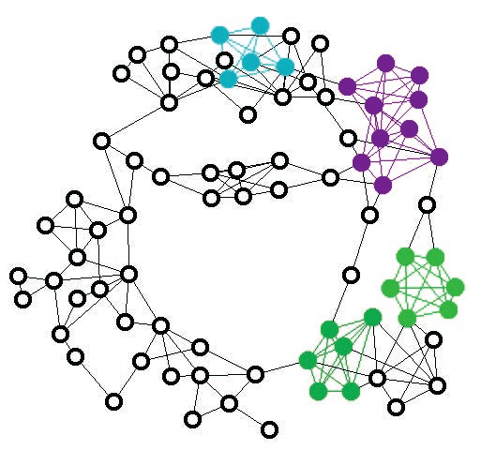
K-Trusses
Relaxation of k-member clique
Non-trivial, single-component maximal subgraph
Every edge is contained
in at least k-2 triangles
in the subgraph

Slide 4
Listing of the Algorithms
simplifyGraph: Edges -> RepresentativeEdges
removes Loops (not cycles)
aggregate duplicate edges
augmentGraphWithDegrees: RepresentativeEdges -> AugmentedEdges
d(v) = |{E | E = (x,y) a. (x = v o. y = v) }|
enumerateTriangles: AugmentedEdges
finds all triangles in a Graph
findComponents: RepresentativeEdges -> ZoneAssignments
finds all components of a graph
findKTrusses: Edges, k -> ZoneAssignments
finds all k-trusses of the graph
each returned vertex v is part of a truss z

Slide 5
K-Trusses
findKTrusses: Edges, k -> ZoneAssignments (v, z)
finds all k-trusses of the graph
each returned vertex v is part of a truss z
simplifyGraph while true do: augmentGraphWithDegrees enumerateTriangles keep only edges contained in k-2 triangles if all edges kept break; done findComponents

Slide 6
Finding Components
findComponents: RepresentativeEdges -> ZoneAssignments
finds all components of a graph, each identified as the order number of the lowest-order vertex contained
consists of:
step 1: find adjacent zones: Edges x Zones -> InterzoneEdges (z, z)
step 2: merge adjacent zones into lowest-order neighbouring zone: InterzoneEdges, ZoneAssignments (v, z) -> Pairs (v, z)
while true do: step 1 if empty set interzone edges break; step 2 done

Slide 7
K-Trusses in MapReduce

